Slide 1

DIABETIC RETINOPATHY DETECTION
Rudolph Almeida 05
Niral Almeida 04
Melissa D’Cunha 20
Date of Presentation: 10th November, 2017
Under the guidance of: Miss. Vincy Joseph
Department of Computer Engineering,
St. Francis Institute of Technology

Slide 2

CONTENTS
Introduction
Problem Statement and Proposed Solution
Scope of Project
Review of Literature
System Description
Hardware and Software Requirements
User Interface Design
Conclusions
Plans for Next Semester
Literature Cited
Acknowledgements
Diabetic Retinopathy Detection

Slide 3
INTRODUCTION
Diabetic Retinopathy is the leading cause of blindness in the developing world
Diabetic Retinopathy is caused by long standing cases of diabetes
It can be stopped if it is detected in time
However, this is difficult as the disease shows little symptoms until it is too late
Diabetic Retinopathy Detection

Slide 4
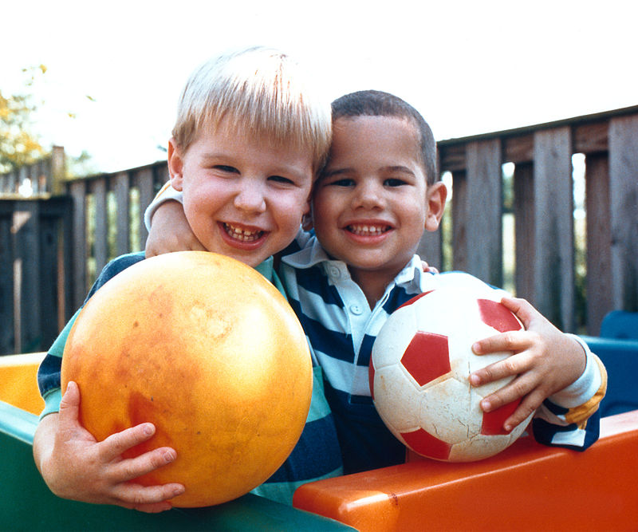
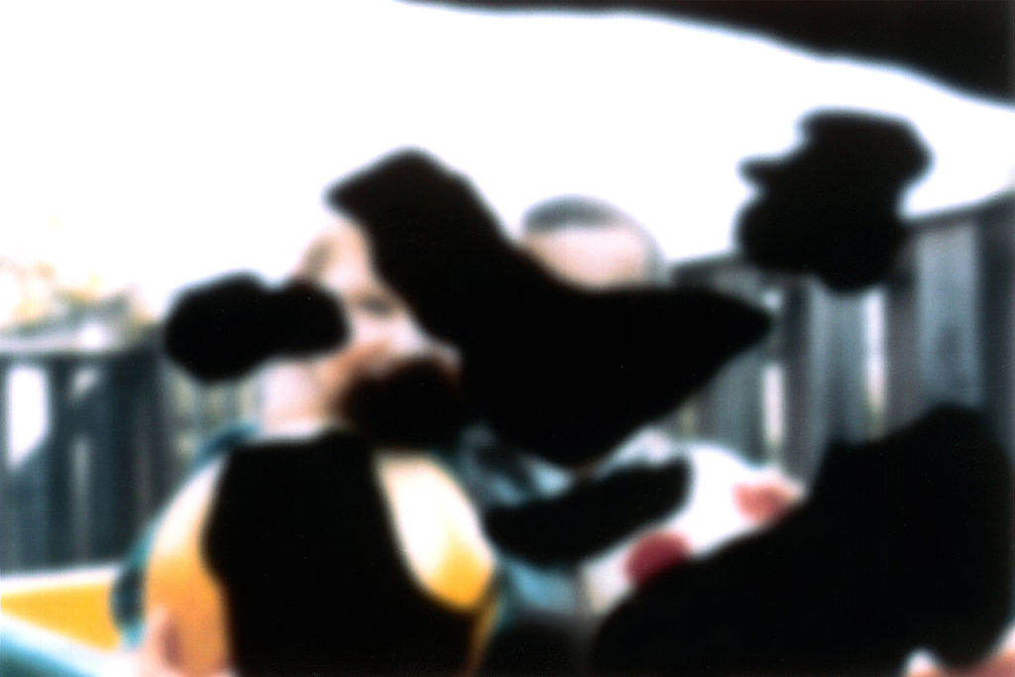
VISION WITH DIABETIC RETINOPATHY
NORMAL VISION
VISION WITH DIABETIC RETINOPATHY
Diabetic Retinopathy Detection

Slide 5
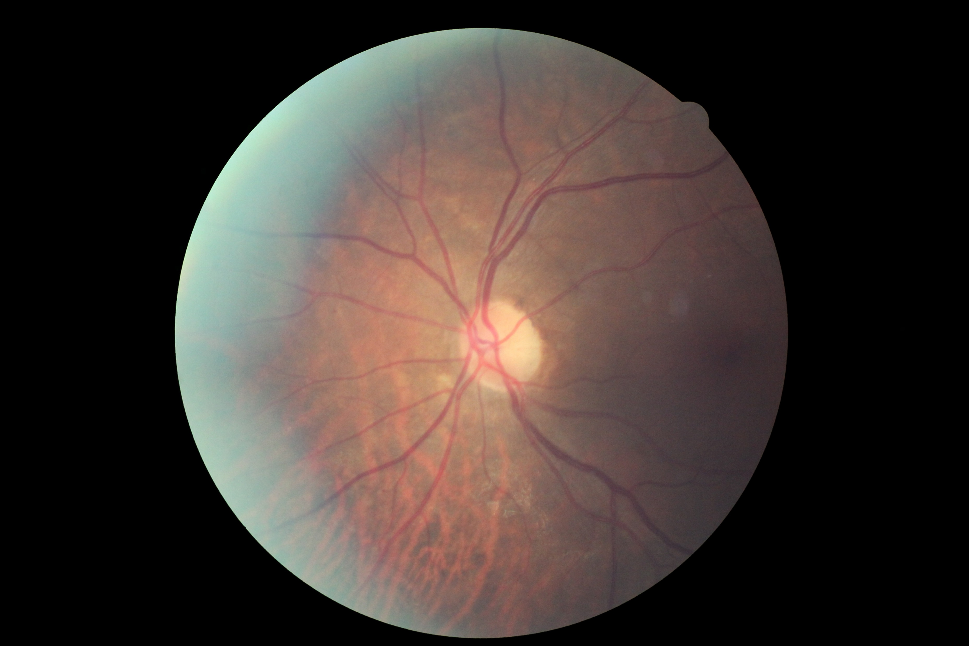
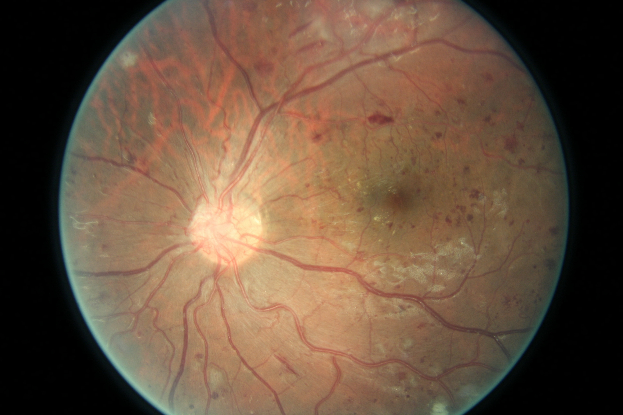
COLOR FUNDUS PHOTOGRAPHS
With Rating 0
No DR
With Rating 4
Proliferative DR
Diabetic Retinopathy Detection

Slide 6
PROBLEM STATEMENT AND PROPOSED SOLUTION
Currently DR detection requires a trained physician, in a manual and time-consuming process.
By the time human readers submit their reviews, often a day or two later, the delayed results lead to lost follow up, miscommunication, and delayed treatment.
We plan at designing a diagnosis model that automatically learns features which are pivotal in diagnosing the stage of the disease without explicit or manual feature extraction
Diabetic Retinopathy Detection

Slide 7
SCOPE OF THE PROJECT
The project is intended to be used by clinical experts and researchers who might want it to use to accurately predict the class of a color fundus photograph.
Clinics can employ the system to provide reports to patients at the earliest. This will hopefully lead to DR being detected at its early stages and thereby reducing the cases of serious DR among the population.
Providing accurate results is necessary and incase the medical expert notices an error made by the system, they will be able to note the error which will then be corrected by the system.
Diabetic Retinopathy Detection

Slide 8
LITERATURE SURVEY – IMAGE PROCESSING
Image preprocessing is the processing of digital images using mathematical operations by using any form of signal processing.
Techniques to be used:
Channel Extraction
Image Reflection about X-axis
Noise Removal
Histogram Equalization
Diabetic Retinopathy Detection

Slide 9

IMAGE PROCESSING –CHANNEL EXTRACTION
Training images on all 3 color channels demand high memory requirements
Hence, images need to be converted to a single channel
Experiments find, green retains information the best
Diabetic Retinopathy Detection

Slide 10
IMAGE PROCESSING - REFLECTION
In our dataset some images are shown as one would see the retina anatomically or through a microscope condensing lens
Such images are characterized by a notch at the top right, rather than bottom right, and will be reflected about the x-axis to get them in proper position
IMAGE PROCESSING – NOISE REMOVAL
Both images and labels in our dataset contain noise
Because we don’t want the classifier to learn the inherent noise as a feature, we need to remove noise from input images
Diabetic Retinopathy Detection

Slide 11
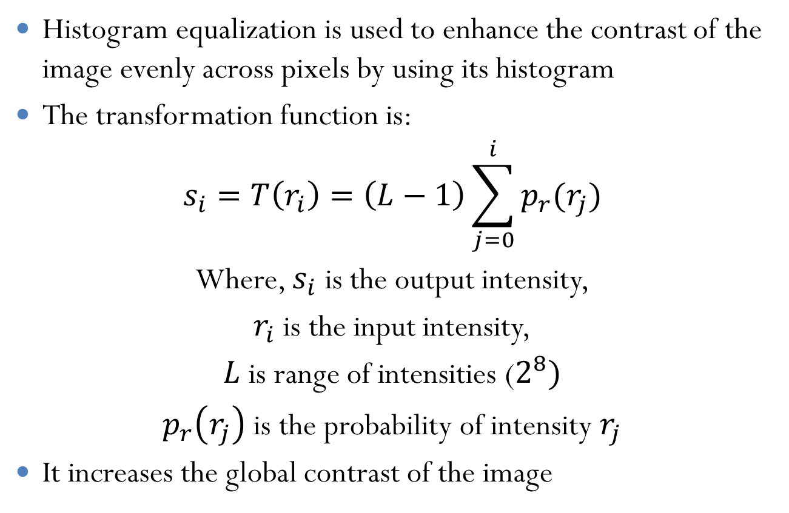
IMAGE PROCESSING – HISTOGRAM EQUALIZATION
Diabetic Retinopathy Detection

Slide 12
LITERATURE SURVEY - CLASSIFICATION
In machine learning and statistics, classification is the problem of identifying to which a set of categories a new observation belongs, on the basis of a training set of data containing observations whose category membership is known. An example would be assigning a given email into “spam” or “not-spam” categories.
Algorithms:
  Naive Bayes Classifier
  Support Vector Machines
  k-Nearest Neighbors
  Random Forests
  Convolutional Neural Networks
Diabetic Retinopathy Detection

Slide 13
LITERATURE SURVEY - ALGORITHMS
Naïve Bayes Classifier: Naïve Bayes classifiers are a family of simple probabilistic classifiers based on applying Bayes’ theorem with string independence assumptions between the features.
Naïve Bayes classifiers are highly scalable, requiring a number of parameters linear in the number of variables in a learning problem.
Maximum-likelihood training can be done by evaluating a closed-form expressing, which takes linear time, rather than by expensive iterative approximation as used for many other types of classifiers.
Diabetic Retinopathy Detection
Notes:
Use citations instead on links

Slide 14
LITERATURE SURVEY - ALGORITHMS
Support Vector Machines: Support vector machines(SVMs) are supervised learning models with associated learning algorithms that analyze data used for classification and regression analysis.
Given a set of training examples, each marked as belonging to one or the other of two categories, an SCM training algorithm builds a model that assigns new examples to one category or the other, making it a non-probabilistic binary linear classifier.
An SVM model is a representation of the examples as points in space, mapped so that the examples of the separate categories are divided by a clear gap that is as wide as possible.
Diabetic Retinopathy Detection

Slide 15
LITERATURE SURVEY - ALGORITHMS
k-Nearest Neighbors: In pattern recognition, the k-nearest neighbor’s algorithm(k-NN) is a non-parametric method used for classification and regressing.
The input consists of the k closest training examples in the feature space. In classification, the output is class membership.
An object is classified by a majority vote of its neighbors, with the object being assigned to the class most common among its k nearest neighbors (k is a positive integer).
Diabetic Retinopathy Detection

Slide 16
LITERATURE SURVEY - ALGORITHMS
Random Forests: Random Forests are an ensemble learning method for classification, regression and other tasks, that operate by constructing a multitude of decision trees at training time and outputting the class that is the mode of the classes of the individual trees.
Random decision forests correct for decision trees habit of overfitting to their training set.
Diabetic Retinopathy Detection

Slide 17
LITERATURE SURVEY - ALGORITHMS
Convolutional Neural Networks: A CNN is comprised of one or more convolutional layers and then followed by one or more fully connected layers as in a standard multilayer neural network
The architecture of a CNN is designed to take advantage of the 2D hierarchical structure of an input image
This is achieved with local connections followed by some form of pooling which results in translation invariant features
Another benefit of CNNs is that they are easier to train and have many fewer parameters than fully connected networks with the same number of hidden layers. CNNS also consider the hierarchical representations of images while training
Diabetic Retinopathy Detection

Slide 18
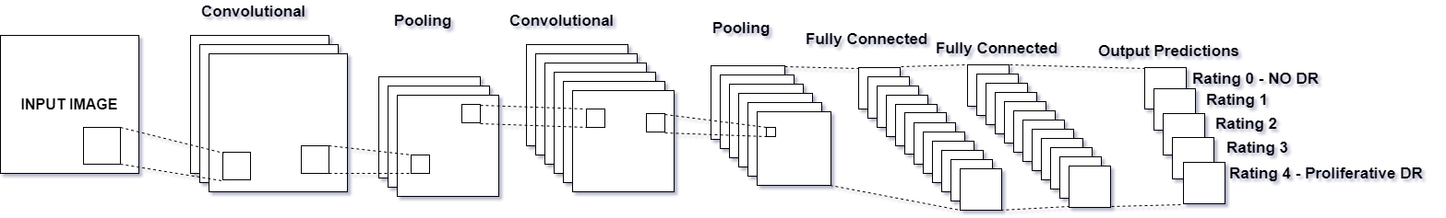
CONVOLUTIONAL NEURAL NETWORK - DIAGRAM
Diabetic Retinopathy Detection

Slide 19
CONVOLUTIONAL NEURAL NETWORKS - COMPONENTS
Convolutional Layers: Convolutional layers apply a convolution operation to the input, passing the result to the next layer. The convolution emulates the response of an individual neuron to visual stimuli.
Pooling Layers: Convolutional networks may include local or global pooling layers, which combine the outputs of neuron clusters at one layer into a single neuron in the next layer.
Fully-Connected Layers: Fully connected layers connect every neuron in one layer to every neuron in another layer. It is in principle the same as the traditional multi-layer perceptron neural network
Diabetic Retinopathy Detection

Slide 20
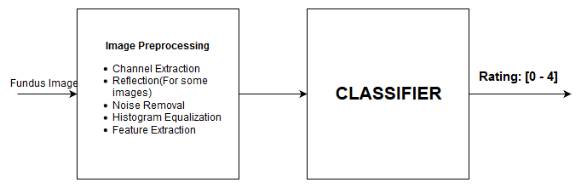
BLOCK DIAGRAM OF SYSTEM
For training and application
Diabetic Retinopathy Detection

Slide 21
BLOCK DIAGRAM OF SYSTEM
As the block diagram shows, the system consists of two major blocks, takes a fundus photograph as input and returns a rating between 0 – 4 as output. The input image is first preprocessed in the “Image Preprocessing” block.
The output of the preprocessing step will either be a processed and transformed image in case of a CNN or a set of features of the image in case of other ML techniques such as Naïve Bayes or SVM. The classifier will then either learn if it is training, or produce an output if it is running in the application.
Diabetic Retinopathy Detection

Slide 22
HARDWARE REQUIREMENTS
Developer
  Minimum 4GB RAM. Higher RAM results in faster training
  Minimum 100GB hard disk space
  Nvidia GPU with minimum CUDA level of 3.0
User
  Minimum 512 MB RAM
  Processor: Minimum Core 2 Duo 2GHz or equivalent
Diabetic Retinopathy Detection

Slide 23
SOFTWARE REQUIREMENTS
Developer
  Linux OS such as Ubuntu or Mint
  Python 3.5 and above
  A rich text editor such as Visual Studio Code. The developer may use any text editor he/she is comfortable with
User
  Basic Operating System such as Windows, Linux or Mac OS
Diabetic Retinopathy Detection

Slide 24
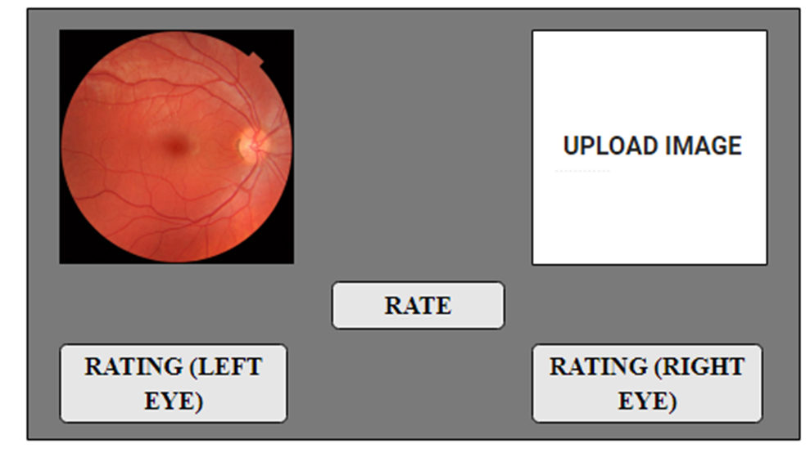
USER INTERFACE DESIGN
Diabetic Retinopathy Detection

Slide 25
CONCLUSIONS
This project aims to build a comprehensive and automated system capable of rating color fundus photographs. The rating will be a value predicting how serious the spread of diabetic retinopathy is for the patient.
The project is meant to be used by in clinical where it can predict the rating of a patient quickly. In the future we hope to make the system more accurate which is a serious requirement of medical diagnosis systems.
The system also needs to be quick to warrant the use of such an automated system.
Diabetic Retinopathy Detection

Slide 26
PLANS FOR NEXT SEMESTER
Next semester we will mainly be focusing on the implementation of the project
We will be designing models and training them on our dataset
We will then evaluate these models based on accuracy or similar performance evaluation and select the one with the best score
We will then implement a desktop application employing the model to predict DR classes based on input images
Diabetic Retinopathy Detection

Slide 27
LITERATURE CITED
"National Diabetes Statistics Report, 2014." Centers for Disease Control and Prevention. January 1, 2014. Accessed December 26, 2014.
"Diabetes." World Health Organization. November 1, 2014. Accessed December 26, 2014. http://www.who.int/mediacentre/factsheets/fs312/en/.
“Convolutional Neural Networks for Diabetic Retinopathy” Harry Pratt, Procedia Computer Science.
“Digital Image Processing”, Gonzalez, Woods.
Diabetic Retinopathy Detection

Slide 28
ACKNOWLEDGEMENTS
Diabetic Retinopathy Detection

Slide 29
THANK YOU!

